Slide 1
Ms Excel tricks

Slide 2
Why we talk about excel
It’s make your life easyer
Can organize everything with it
Little energy input, huge knowladge output

Slide 3
Topicks
Wild card
Lock references
Short cuts
VBA

Slide 4
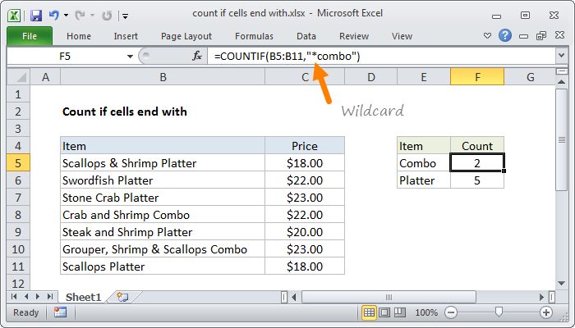
Wildcards
Helps you find what are you looking for

Slide 5
Lock references
Basic numbers |  |  | multiply with | mulriplied numbers
95 | 19 | 80 | 6 | =A2*$D$2 | 114 | 480
9 | 38 | 43 |  | 54 | 228 | 258
59 | 10 | 61 |  | 354 | 60 | 366
56 | 32 | 44 |  | 336 | 192 | 264

Slide 6
Short cuts
Current time
Ctrl + Shft + dot
Current date
Ctrl + 0
Hide column
Ctrl + (
Hide row
Ctrl + )
Select column
Ctrl + space
Select row
Shft + space
New row in cell
Alt + enter

Slide 7
VBA
Write macros for repetitive task
Make task easier
Works for you, if written the right way
Easy to learn with practise
Tons of learning material on the internet

Slide 8
Thank you for your attention

